Slide 1

Working Of Self Driving Vehicles
J.Yashaswi
9 B

Slide 2
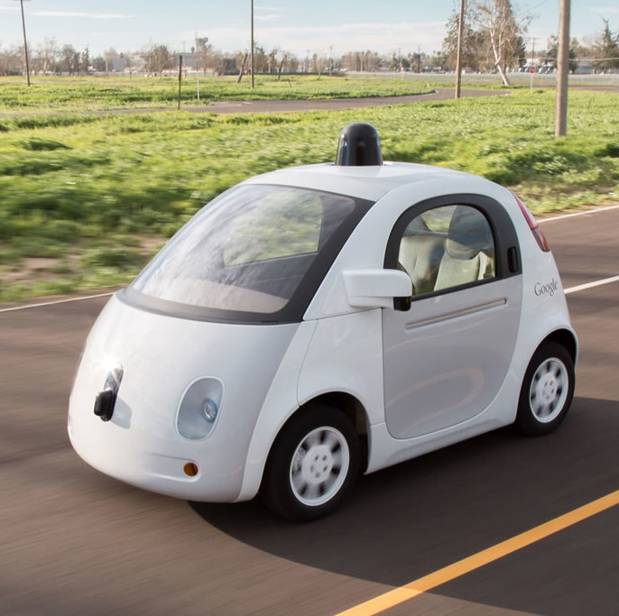
WHAT ARE SELF DRIVING VEHICLES?
Self-driving vehicles can also be called autonomous vehicles.
These vehicles can drive itself from the start point to the predetermined destination using autopilot, sensors and in-vehicles technologies.

Slide 3
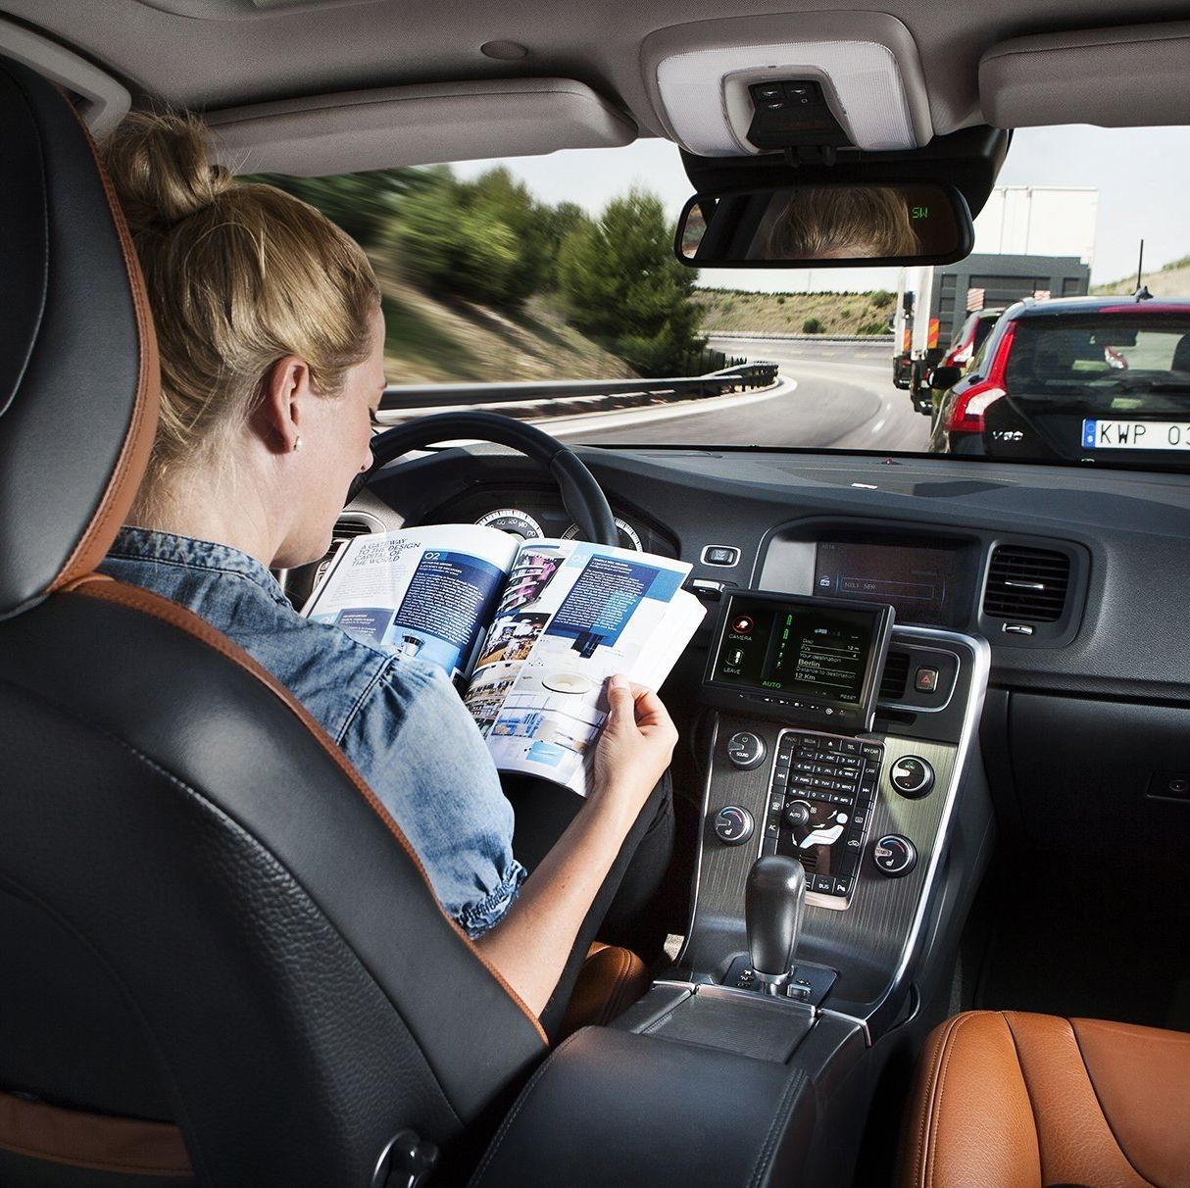
WHAT IS THE STATUS OF SELF-DRIVING CARS?
Despite extraordinary efforts from many of the leading names in tech and in automaking, fully autonomous cars are still out of reach except in special trial programs.
This Photo by Unknown author is licensed under CC BY-NC-ND.

Slide 4
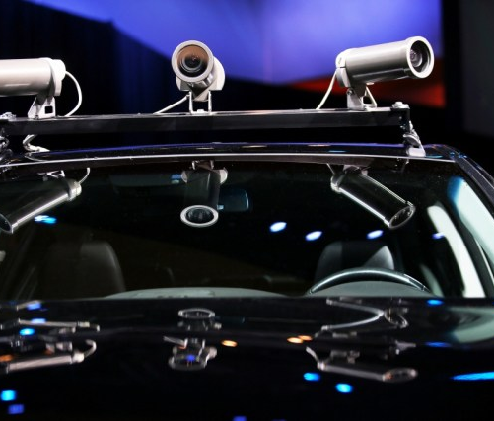
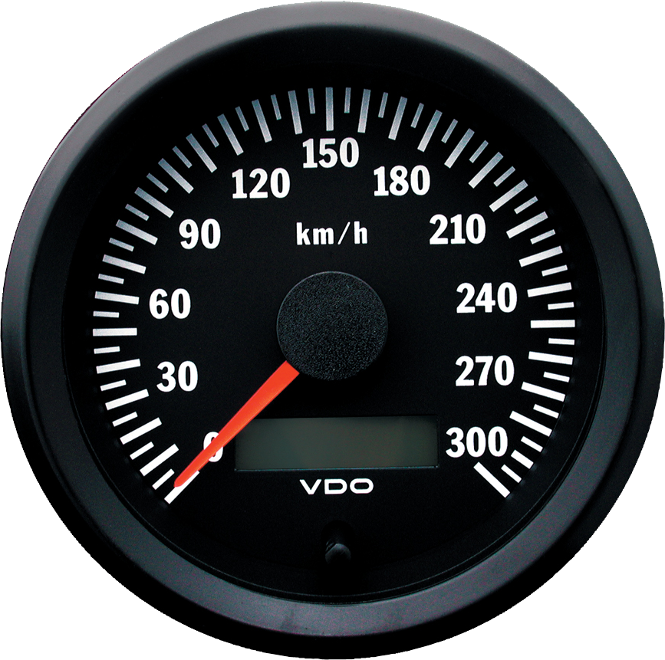
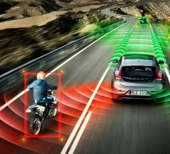
HOW WILL AUTONOMOUS CARS WORK?
Autonomous cars will rely on sensors, actuators, complex algorithms, machine learning systems, and powerful processors to execute software.
Autonomous cars will create and maintain a map of their surroundings based on a variety of sensors situated in different parts of the vehicle.
The vehicle will automatically control its speed and steering without the driver having to touch a pedal or the steering wheel.

Slide 5
PROS AND CONS OF SELF-DRIVING VEHICLES
Pros
Cons
Reduced vehicle crashes.
More efficient travel .
Decreased traffic flow.
Easier access for the disabled and elderly.
Wild adoption is necessary to make it work.
Massive job loss in transportation sector.
Hackers and cyber threats.
High upfront cost.

Slide 6


